Slide 1


FINDING THE SHORTEST PATH PREVENTING SEXUAL HARASSMENT THROUGH ALGORITHMS

Slide 2



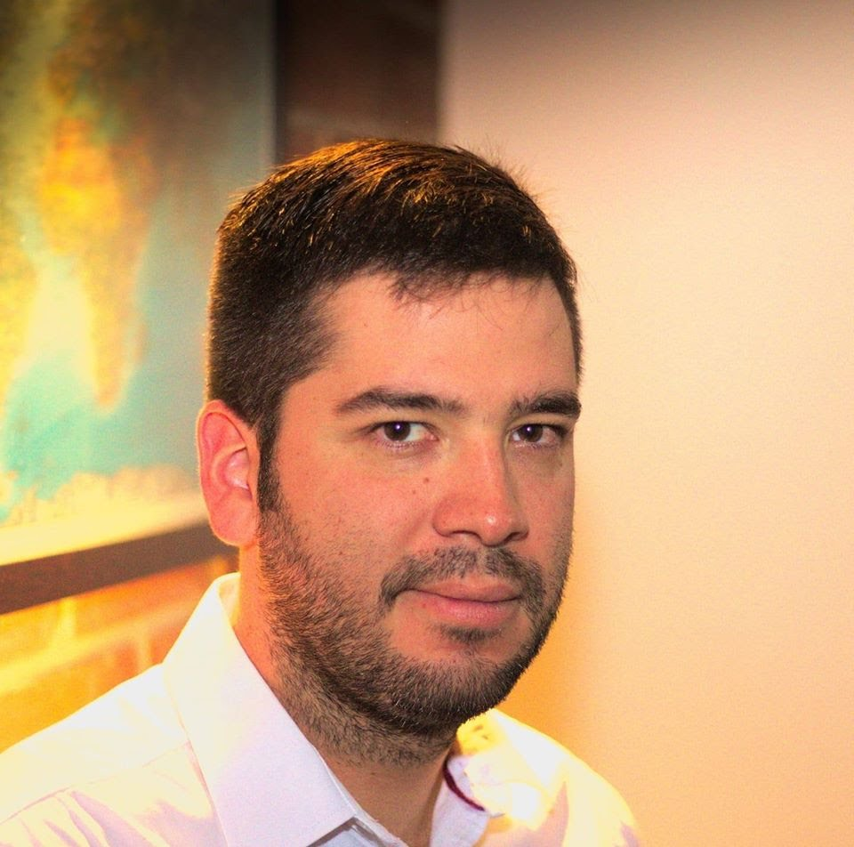


Presentation of the team
Juan Felipe Restrepo
Author
Sara Valentina Cortes
Author
Andrea Serna
Literature review
Mauricio Toro
Data preparation
https://github.com/JuanFelipeRestrepoBuitrago/ST0245

Slide 3
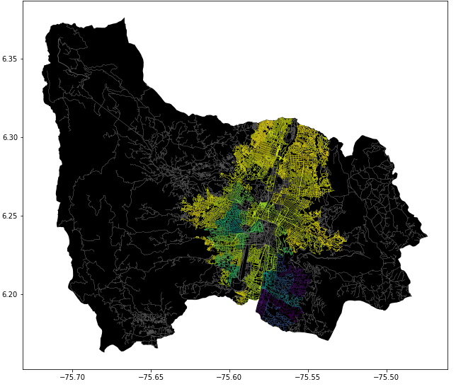
Problem Statement
Shortest path algorithm
Streets
of Medellín, Origin and Destination
Three paths that reduce both the risk of harassment and distance

Slide 4
Solution Algorithm
Dijkstra Algorithm
Streets
of Medellín, Origin and Destination
A path that reduces both distance and harassment

Slide 5
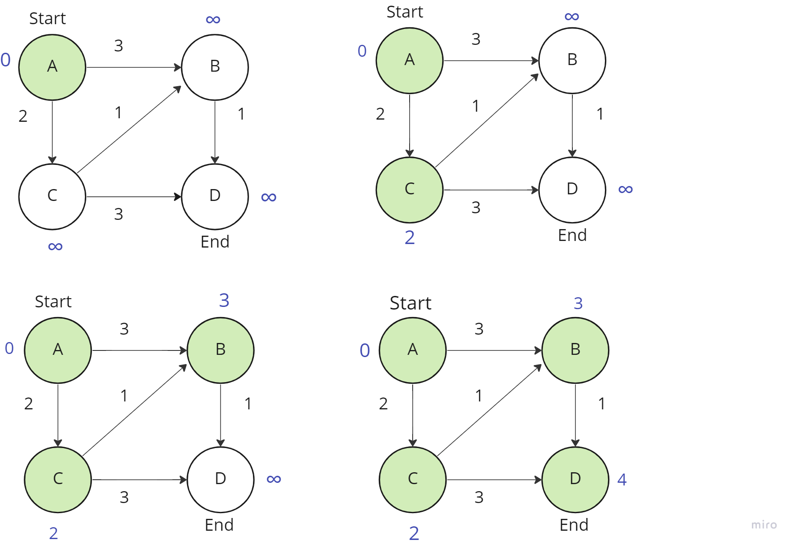

Explanation of the algorithm
Dijkstra Algorithm for the Shortest Path

